Slide 1
Context-Free Languages & Grammars (CFLs & CFGs)

Slide 2
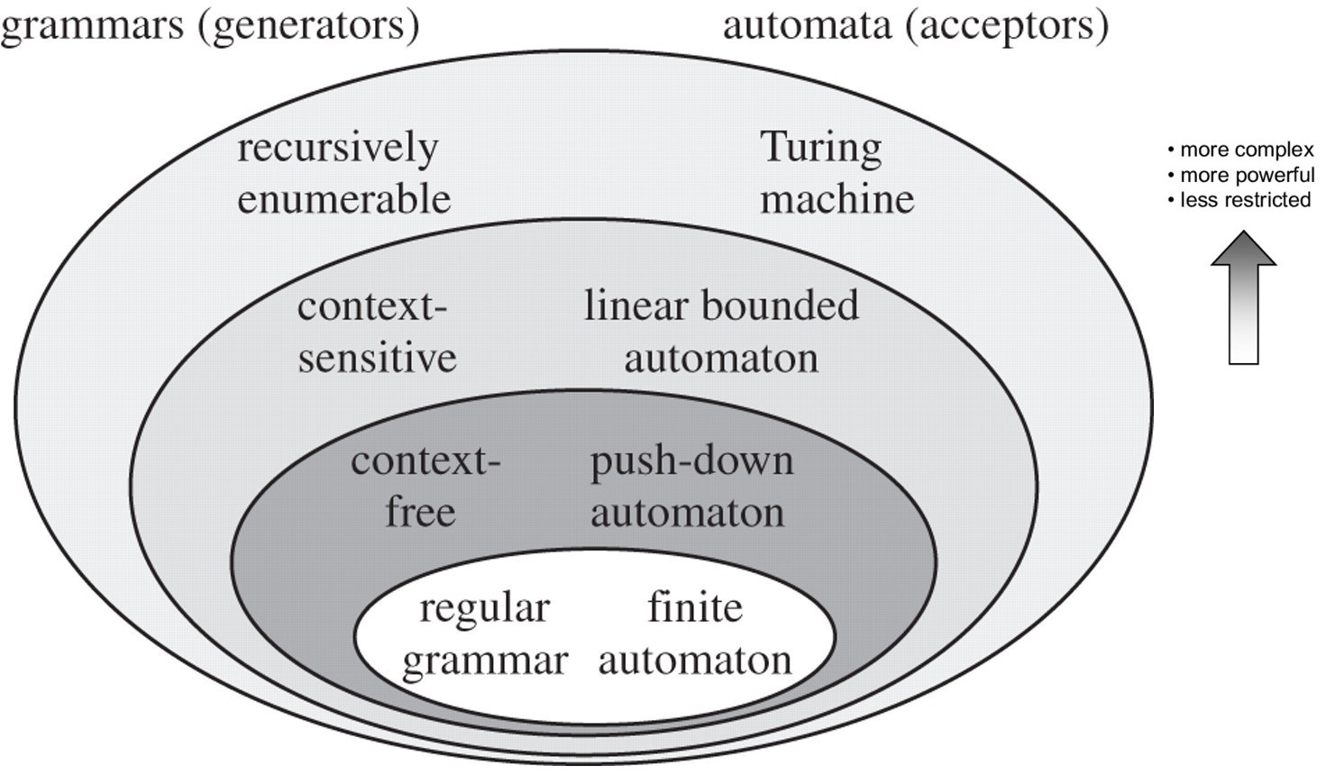
Relation ship among Formal Languages

Slide 3
Not all languages are regular
So what happens to the languages which are not regular?
Can we still come up with a language recognizer?
i.e., something that will accept (or reject) strings that belong (or do not belong) to the language?

Slide 4
Context-Free Languages
A language class larger than the class of regular languages
Supports natural, recursive notation called “context-free grammar”
Applications:
Parse trees, compilers
XML
Context- free
(PDA/CFG)
Regular
(FA/RE)

Slide 5
An Example
A palindrome is a word that reads identical from both ends
E.g., madam, redivider, malayalam, 010010010
Let L = { w | w is a binary palindrome}
Is L regular?
No.
Proof:
Let w=0^{N}10N (assuming N to be the p/l constant)
By Pumping lemma, w can be rewritten as xyz, such that xy^{k}z is also L (for any k≥0)
But |xy|≤N and y≠ε
==> y=0⁺
==> xy^{k}z will NOT be in L for k=0
==> Contradiction

Slide 6
But the language of palindromes…
is a CFL, because it supports recursive substitution (in the form of a CFG)
This is because we can construct a “grammar” like this:
A ==> ε
A ==> 0
A ==> 1
A ==> 0A0
A ==> 1A1
Terminal
Same as: A => 0A0 | 1A1 | 0 | 1 | ε
Variable or non-terminal
Productions

Slide 7
How does the CFG for palindromes work?
An input string belongs to the language (i.e., accepted) iff it can be generated by the CFG
Example: w=01110
G can generate w as follows:
A => 0A0
=> 01A10
=> 01110
G: A => 0A0 | 1A1 | 0 | 1 | ε
Generating a string from a grammar:
Pick and choose a sequence of productions that would allow us to generate the string.
At every step, substitute one variable with one of its productions.

Slide 8
Context-Free Grammar: Definition
A context-free grammar G=(V,T,P,S), where:
V: set of variables or non-terminals
T: set of terminals (= alphabet U {ε})
P: set of productions, each of which is of the form V ==> α₁ | α₂ | …
Where each α_{i} is an arbitrary string of variables and terminals
S ==> start variable
CFG for the language of binary palindromes:
G=({A},{0,1},P,A)
P: A ==> 0 A 0 | 1 A 1 | 0 | 1 | ε

Slide 9
More examples
Parenthesis matching in code
Syntax checking
In scenarios where there is a general need for:
Matching a symbol with another symbol, or
Matching a count of one symbol with that of another symbol, or
Recursively substituting one symbol with a string of other symbols

Slide 10
Example #2
Language of balanced paranthesis
e.g., ()(((())))((()))….
CFG?
G: S => (S) | SS | ε
How would you “interpret” the string “(((()))()())” using this grammar?

Slide 11
Example #3
A grammar for L = {0^{m}1^{n} | m≥n}
CFG?
G: S => 0S1 | A
A => 0A | ε
How would you interpret the string “00000111” using this grammar?

Slide 12
Example #4
A program containing if-then(-else) statements
if Condition then Statement else Statement
(Or)
if Condition then Statement
CFG?

Slide 13
More examples
L₁ = {0^{n} | n≥0 }
L₂ = {0^{n} | n≥1 }
L₃={0^{i}1^{j}2^{k} | i=j or j=k, where i,j,k≥0}
L₄={0^{i}1^{j}2^{k} | i=j or i=k, where i,j,k≥1}

Slide 14
Applications of CFLs & CFGs
Compilers use parsers for syntactic checking
Parsers can be expressed as CFGs
Balancing paranthesis:
B ==> BB | (B) | Statement
Statement ==> …
If-then-else:
S ==> SS | if Condition then Statement else Statement | if Condition then Statement | Statement
Condition ==> …
Statement ==> …
C paranthesis matching { … }
Pascal begin-end matching
YACC (Yet Another Compiler-Compiler)

Slide 15
More applications
Markup languages
Nested Tag Matching
HTML
<html> …<p> … <a href=…> … </a> </p> … </html>
XML
<PC> … <MODEL> … </MODEL> .. <RAM> … </RAM> … </PC>

Slide 16
Simple Expressions…
We can write a CFG for accepting simple expressions
G = (V,T,P,S)
V = {E,F}
T = {0,1,a,b,+,*,(,)}
S = {E}
P:
E ==> E+E | E*E | (E) | F
F ==> aF | bF | 0F | 1F | a | b | 0 | 1

Slide 17
Context-Free Language
The language of a CFG, G=(V,T,P,S), denoted by L(G), is the set of terminal strings that have a derivation from the start variable S.
L(G) = { w in T* | S ==>*_{G} w }

Slide 18
Left-most & Right-most Derivation Styles
G: E => E+E | E*E | (E) | F
F => aF | bF | 0F | 1F | ε
Derive the string a*(ab+10) from G:
E =*=>_{G} a*(ab+10)
E
==> E * E
==> F * E
==> aF * E
==> a * E
==> a * (E)
==> a * (E + E)
==> a * (F + E)
==> a * (aF + E)
==> a * (abF + E)
==> a * (ab + E)
==> a * (ab + F)
==> a * (ab + 1F)
==> a * (ab + 10F)
==> a * (ab + 10)
E
==> E * E
==> E * (E)
==> E * (E + E)
==> E * (E + F)
==> E * (E + 1F)
==> E * (E + 10F)
==> E * (E + 10)
==> E * (F + 10)
==> E * (aF + 10)
==> E * (abF + 0)
==> E * (ab + 10)
==> F * (ab + 10)
==> aF * (ab + 10)
==> a * (ab + 10)
Left-most derivation:
Right-most derivation:
Always substitute leftmost variable
Always substitute rightmost variable

Slide 19
Parse trees

Slide 20
Parse Trees
Each CFG can be represented using a parse tree:
Each internal node is labeled by a variable in V
Each leaf is terminal symbol
For a production, A==>X₁X₂…X_{k}, then any internal node labeled A has k children which are labeled from X₁,X₂,…X_{k} from left to right
Parse tree for production and all other subsequent productions:
A ==> X₁..X_{i}..X_{k}
A
X₁
…
X_{i}
…
X_{k}

Slide 21
Examples
E
E
+
E
A
0
A
0
F
F
Recursive inference
1
A
1
a
1
Derivation
ε
Parse tree for 0110
Parse tree for a + 1
G: E => E+E | E*E | (E) | F
F => aF | bF | 0F | 1F | 0 | 1 | a | b
G: A => 0A0 | 1A1 | 0 | 1 | ε

Slide 22
Parse Trees, Derivations, and Recursive Inferences
Production:
A ==> X₁..X_{i}..X_{k}
A
X₁
…
X_{i}
…
X_{k}
Recursive
inference
Derivation
Left-most derivation
Parse tree
Derivation
Right-most derivation
Recursive inference

Slide 23
Connection between CFLs and RLs

Slide 24
Some Examples
0
1
0,1
0
1
1
0
A
B
C
1
0
A
B
C
1
0
Right linear CFG?
Right linear CFG?

Slide 25
Ambiguity in CFGs and CFLs

Slide 26
Ambiguity in CFGs
A CFG is said to be ambiguous if there exists a string which has more than one left/right-most derivation
Example:
S ==> AS | ε
A ==> A1 | 0A1 | 01
LM derivation #1:
S => AS
=> 0A1S =>0A11S => 00111S => 00111
LM derivation #2:
S => AS => A1S => 0A11S => 00111S => 00111
Input string: 00111
Can be derived in two ways

Slide 27
Why does ambiguity matter?
Values are different !!!
E ==> E + E | E * E | (E) | a | b | c | 0 | 1
string = a * b + c
E
LM derivation #1:
E => E + E => E * E + E ==>* a * b + c
E
+
E
(a*b)+c
E
*
E
c
a
b
E
LM derivation #2
E => E * E => a * E => a * E + E ==>* a * b + c
E
*
E
a*(b+c)
a
E
+
E
The calculated value depends on which of the two parse trees is actually used.
b
c

Slide 28
Inherently Ambiguous CFLs
However, for some languages, it may not be possible to remove ambiguity
A CFL is said to be inherently ambiguous if every CFG that describes it is ambiguous
Example:
L = { a^{n}b^{n}c^{m}d^{m} | n,m≥ 1} U {a^{n}b^{m}c^{m}d^{n} | n,m≥ 1}
L is inherently ambiguous
Why?
Input string: a^{n}b^{n}c^{n}d^{n}

Slide 29
Thank you

